Slide 1

Network & System Administration
3.0 Operating Systems and Programming

Slide 2
Week | 3rd Week
Day
Duration | 4hrs
Agenda
TIME | TOPIC & ACTIVITY | CPMPLETED-
30 Mins | Installation, configuration, and management of operating systems (e.g., Windows, Linux) | Yes/No
60 Mins | User and group administration | Yes/No
15 Mins | Break | Yes/No
45 Mins | File system management | Yes/No
30 Mins | Q&A Session on lesson learnt | Yes/No
15 Mins | Break | Yes/No
60 Mins | Python programming | Yes/No
15 Mins | Group Discussion | Yes/No

Slide 3
Learning Objectives
3.1 Installation, configuration, and management of operating systems (e.g., Windows, Linux)
3.2 User and group administration
3.3 File system management
3.4 Python programming Virtualization and Cloud Computing

Slide 4
3.1 Installation, Configuration, and Management of Operating Systems

Slide 5
What is an Operating System?
Operating System lies in the category of system software. It basically manages all the resources of the computer. An operating system acts as an interface between the software and different parts of the computer or the computer hardware. The operating system is designed in such a way that it can manage the overall resources and operations of the computer.
Operating System is a fully integrated set of specialized programs that handle all the operations of the computer. It controls and monitors the execution of all other programs that reside in the computer, which also includes application programs and other system software of the computer. Examples of Operating Systems are Windows, Linux, Mac OS, etc.
Objectives of Operating Systems?
Convenient to Use.
User Friendly Easy Access.
Management of Resources.
Fair Sharing of Resources.

Slide 6
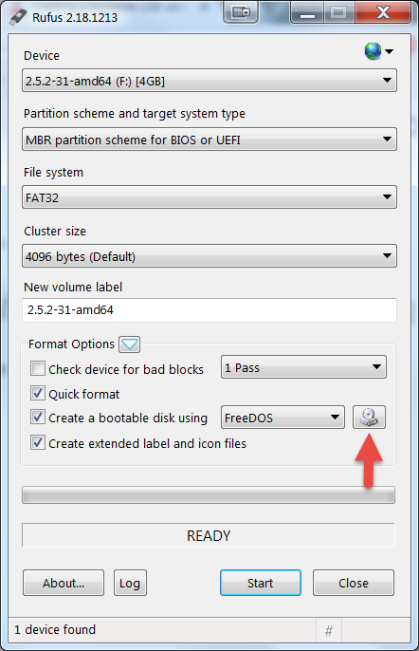
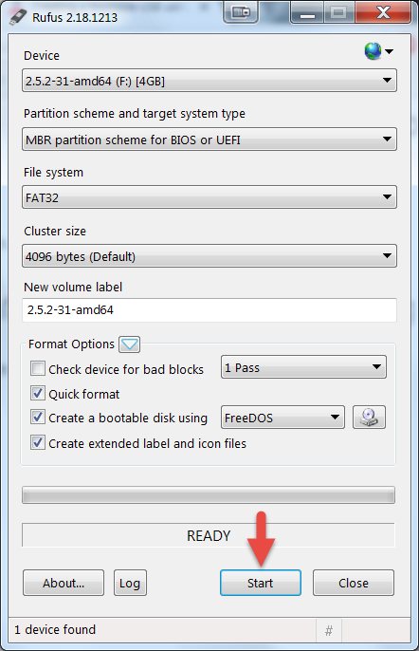
Installation of a Operating System
Creating a Bootable Drive.
Download Rufus (https://rufus.ie/en/).
Open the Application.
Select the ISO File.
Start the Process of Creating a Bootable USB Drive.

Slide 7
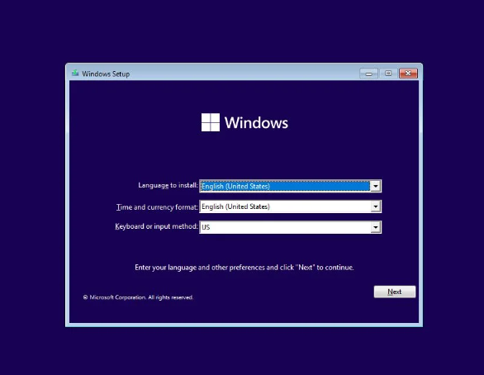
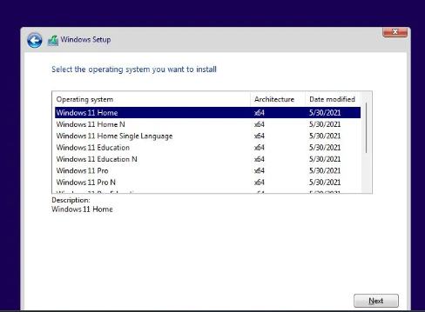
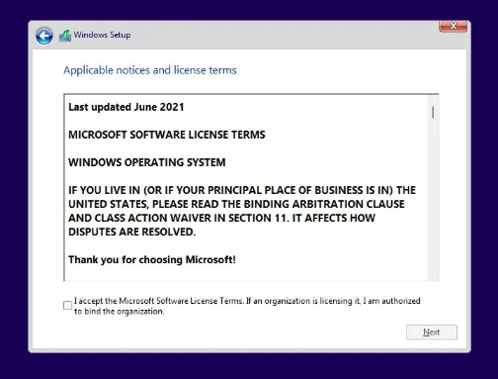
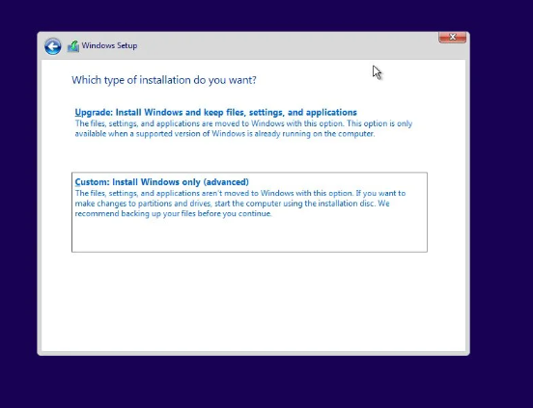
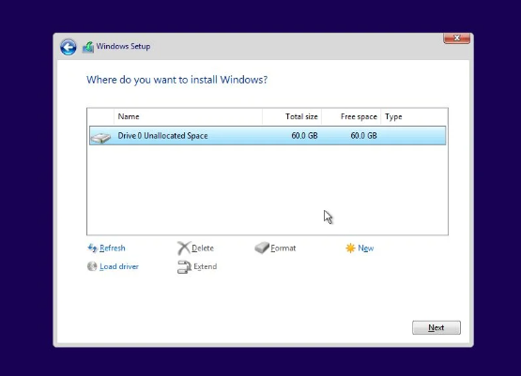
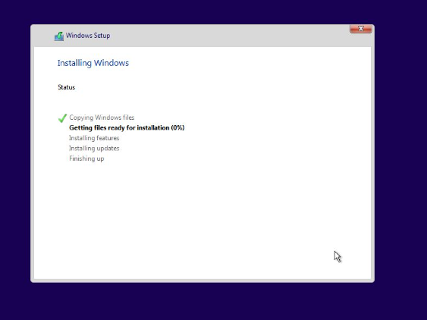
Installation and Configuration of a Operating System
Installation and configuration of Windows 11.

Slide 8
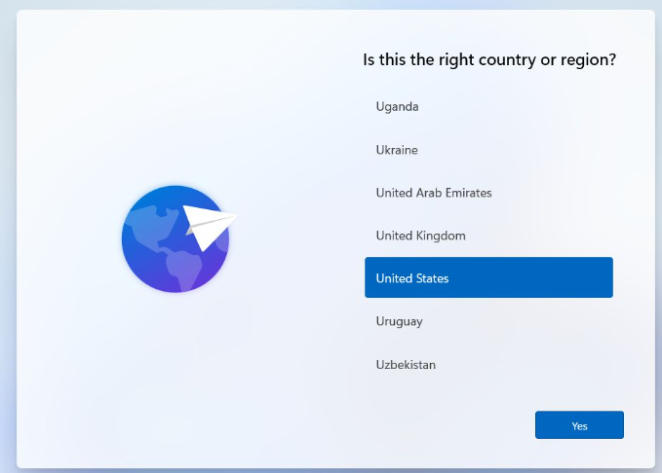
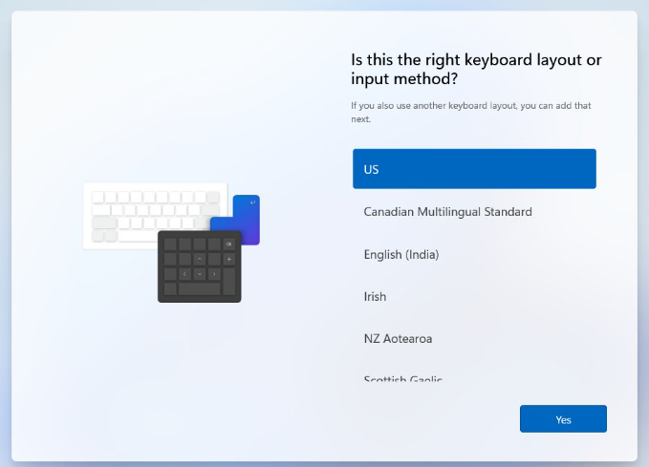
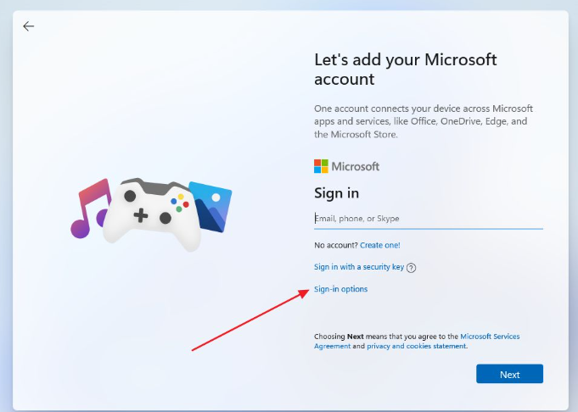
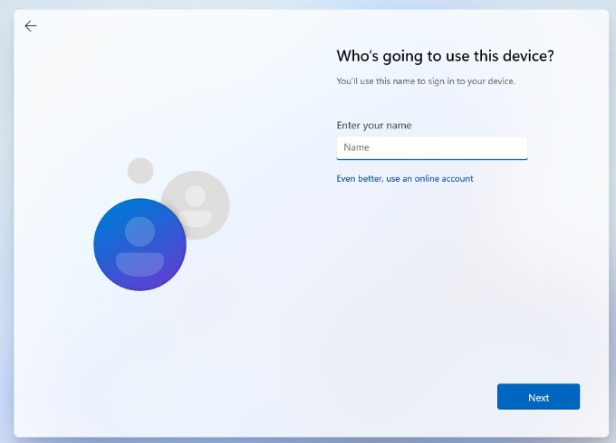
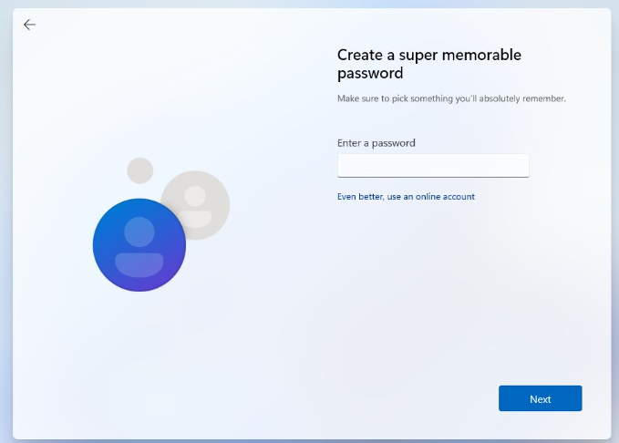
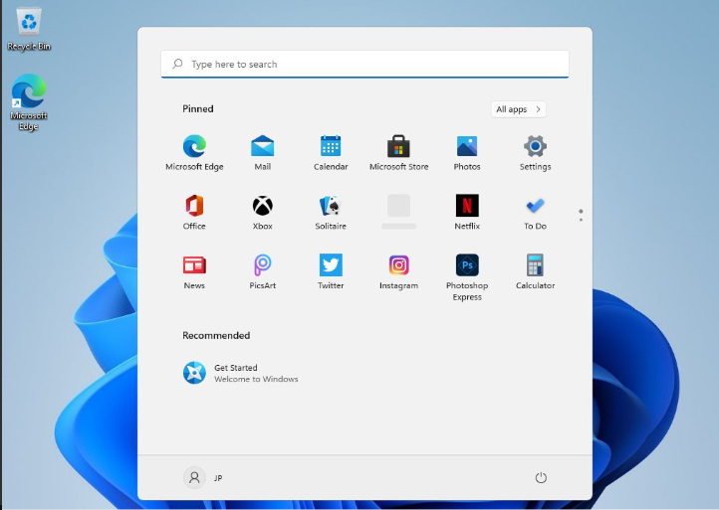
Installation and Configuration of a Operating System
Installation and configuration of Windows 11.

Slide 9
Installation and Configuration of a Operating System
Installation and configuration of Ubuntu.
1. Prepare for Installation
Checking Requirements:
A computer with at least 2 GB of RAM (4 GB recommended).
At least 25 GB of free disk space.
A USB flash drive with at least 4 GB capacity.
Internet connection (optional but recommended).
2. Download Ubuntu:
Visit the official Ubuntu website.
Use a tool like Rufus (Windows) or Etcher (Windows, macOS, Linux) to create Bootable device.

Slide 10
Installation and Configuration of a Operating System
Installation and configuration of Ubuntu.
3. Install Ubuntu
Starting Installation:
Select "Install Ubuntu".
Choose Language: Select your preferred language and click "Continue".
Keyboard Layout: Select the correct keyboard layout and click "Continue".
4. User Information: Enter your name, computer name, username, and password.
5. Complete the Installation
6. Post-Installation Setup
After rebooting, log in with the username and password you created.
Follow any on-screen instructions to complete the initial setup (e.g., connecting to Wi-Fi, setting up online accounts).

Slide 11
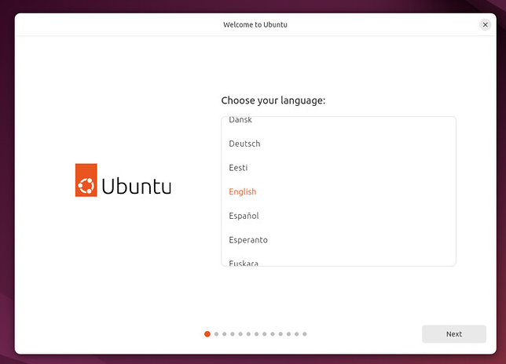
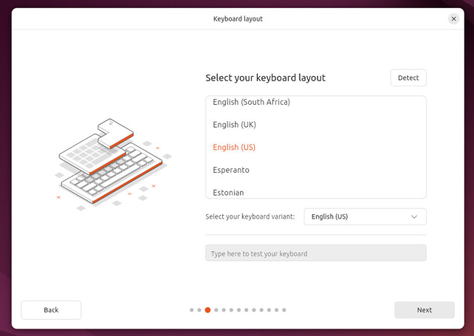
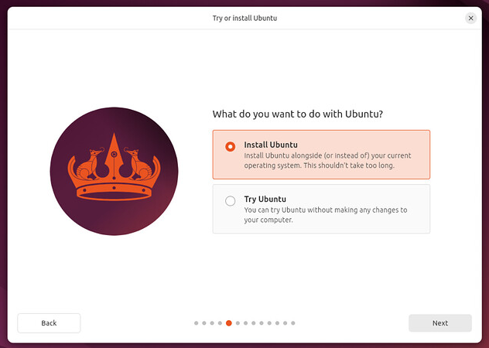
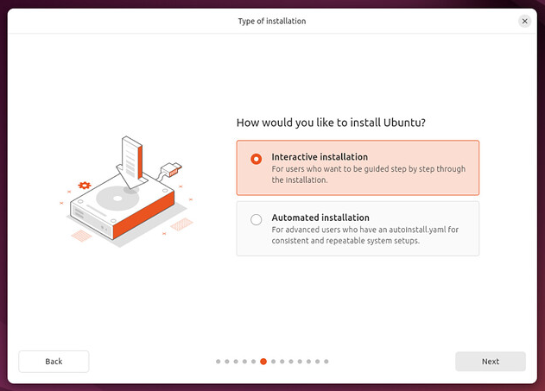
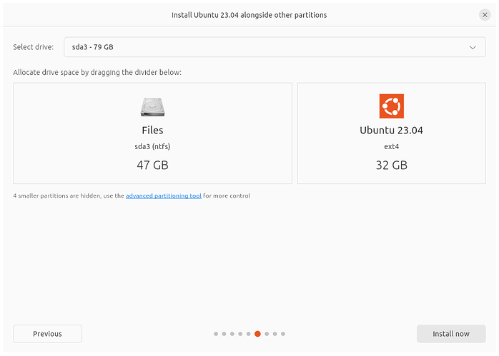
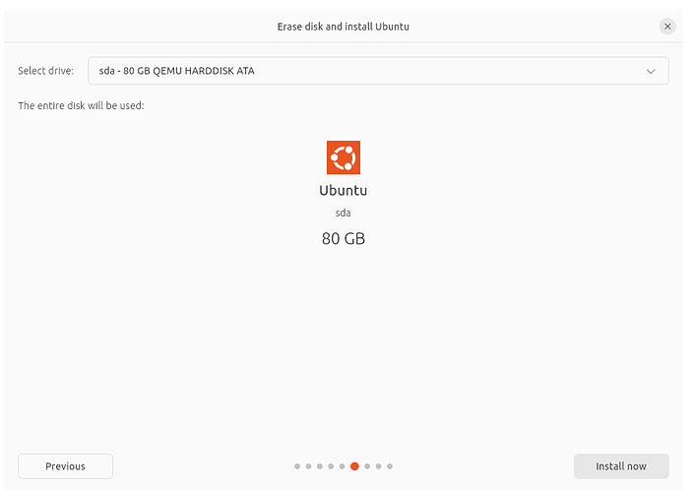
Installation and Configuration of a Operating System
Installation and configuration of Ubuntu.

Slide 12
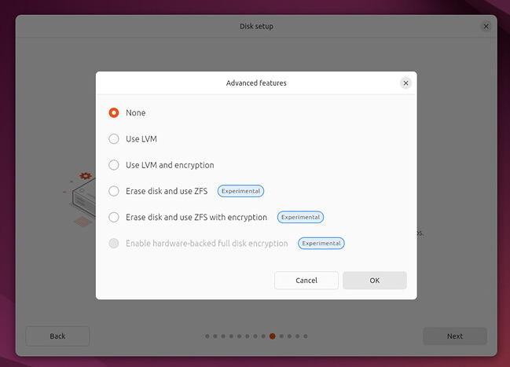
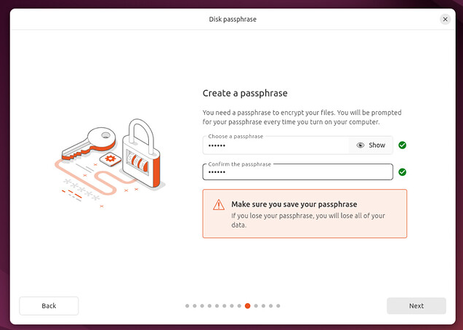
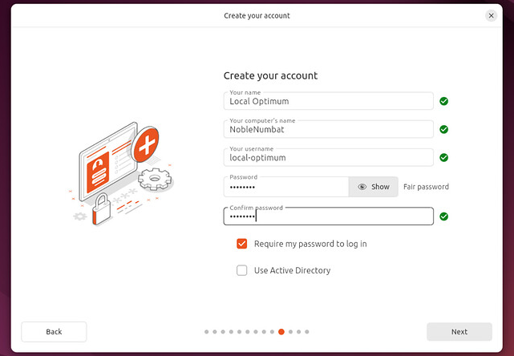
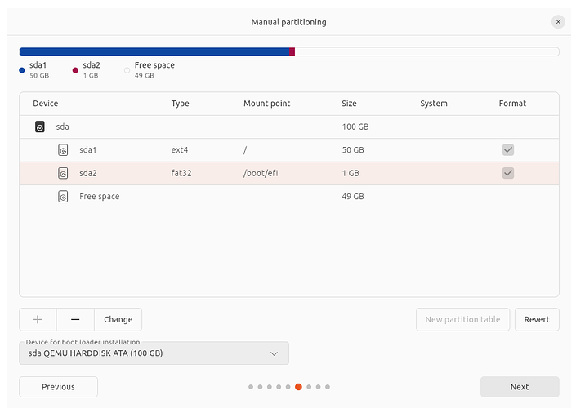
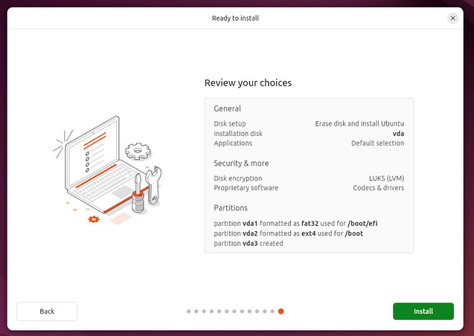
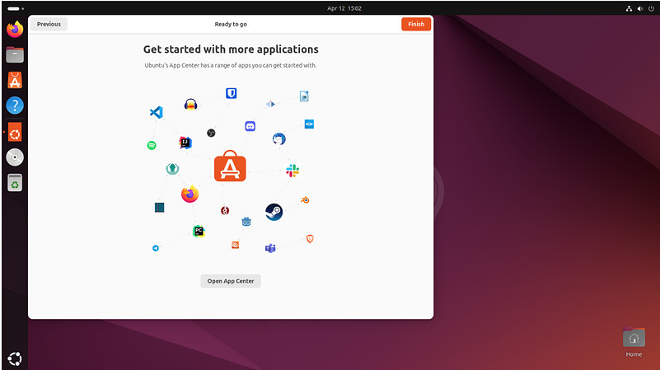
Installation and Configuration of a Operating System
Installation and configuration of Ubuntu.

Slide 13
Managing of a Operating System
Managing Windows
Management Tasks:
System updates and patches
Disk management: Partitioning, defragmentation, cleanup
Performance monitoring: Task Manager, Resource Monitor
Backup and restore
Troubleshooting: Event Viewer, System Restore
Managing Linux
Management Tasks:
System updates and patches
Disk management: fdisk, df, du
Performance monitoring: top, htop, vmstat
Backup and restore: rsync, tar, cron jobs
Troubleshooting: log files, dmesg, syslog

Slide 14
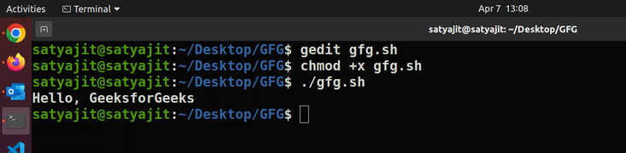
How to Write Bash Scripts?
To write a Bash Script we will follow the steps –
First, we will create a file with the .sh extension.
Next, we will write down the bash scripts within it
After that, we will provide execution permission to it.
This will tell, the system to use Bash for execution. Then we can write our own scripts.
Let’s write down just a simple script that will print some lines in the terminal. The code for it will be –
#!/bin/bash echo "Hello, GeeksforGeeks"
Now we will save the file and provide the execution permission to it. To do so use the following command –
chmod +x scriptname.sh
Next to execute the following script we will use the following command –
./scriptname.sh
Here is the terminal shell pictorial depiction after executing the above commands as follows:

Slide 15
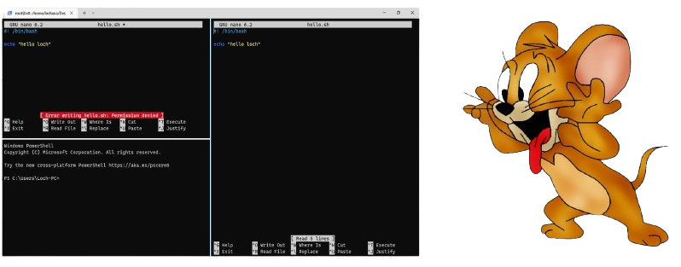
Permission Issues
How to Fix?

Slide 16
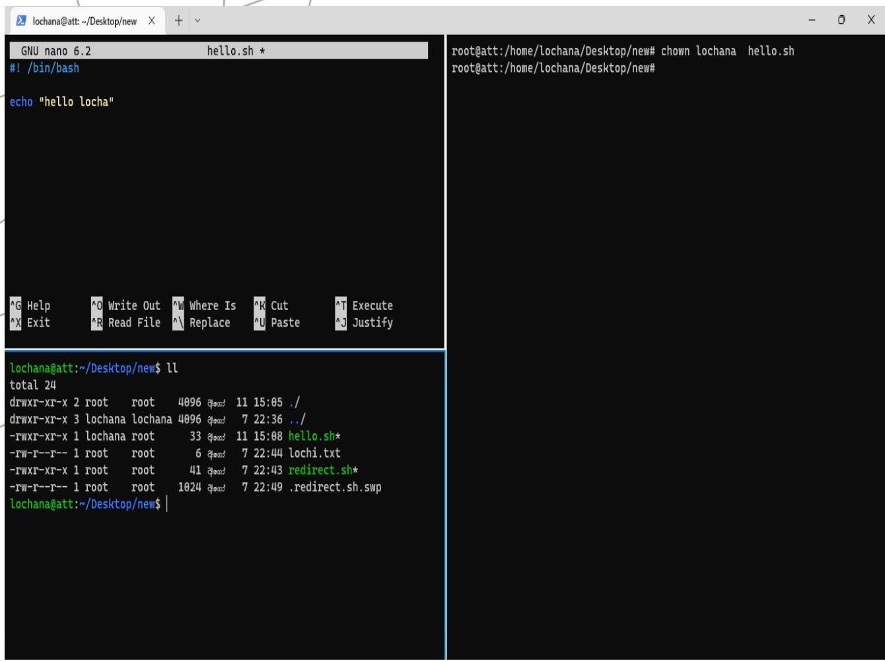
Solution (chown : Linux chown command is used to change a file’s ownership )
The Linux system may have multiple users. Every user has a unique name and user ID. If only a user is available in the system, the user will be the owner of each file.
The Linux system may have multiple users. Every user has a unique name and user ID. If only a user is available in the system, the user will be the owner of each file.
Users can be listed in different groups. The group allows us to set permission on the group level instead of setting permission on an individual level.

Slide 17
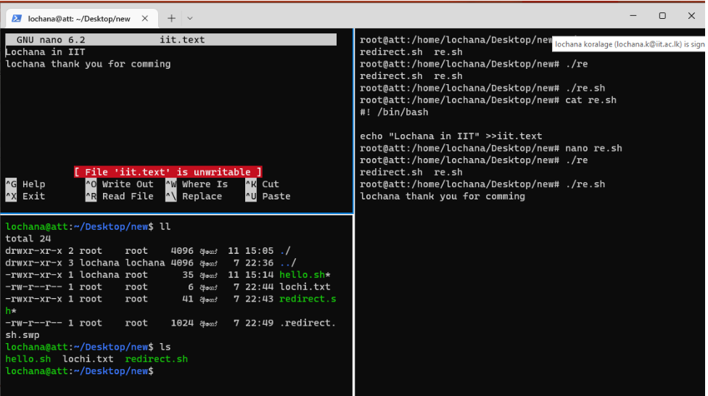
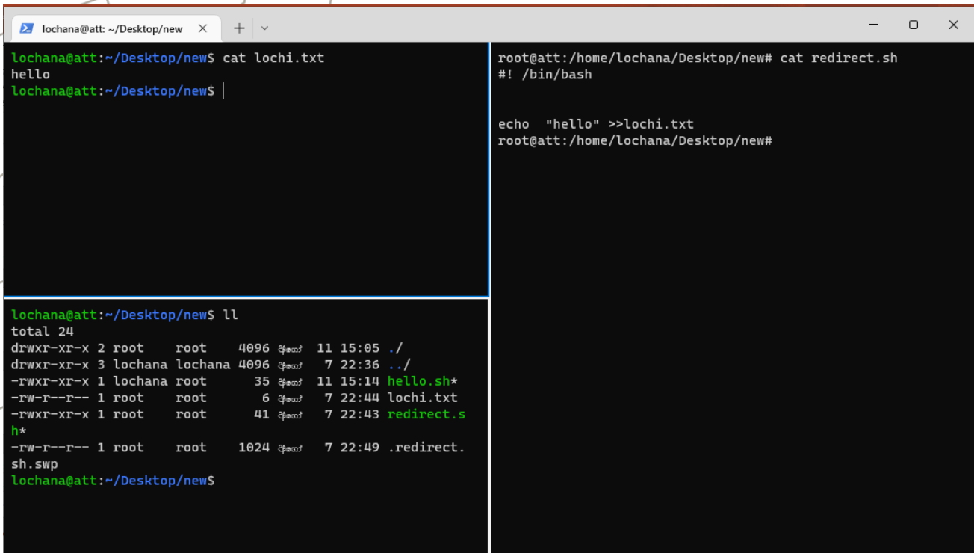
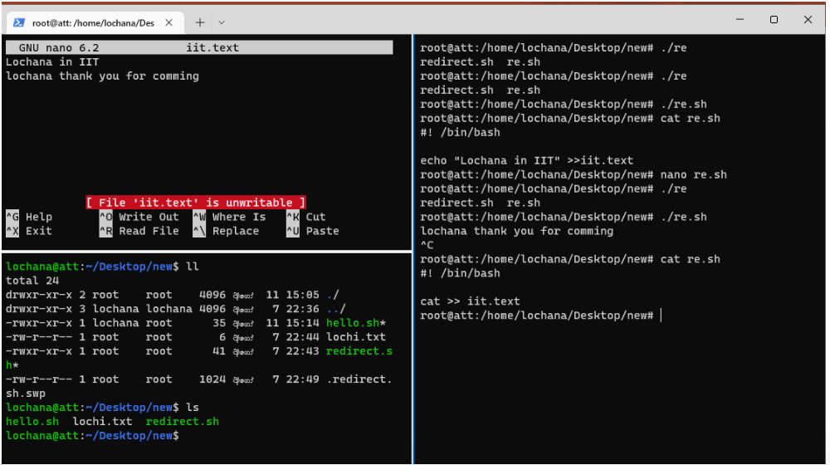
Redirect file content

Slide 18
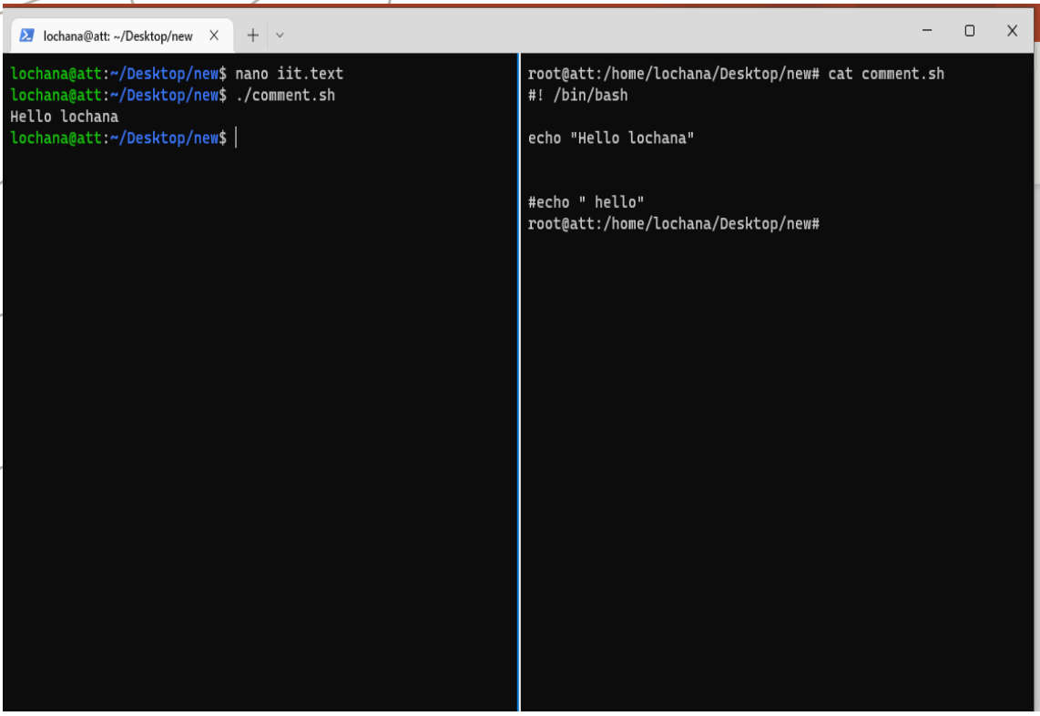
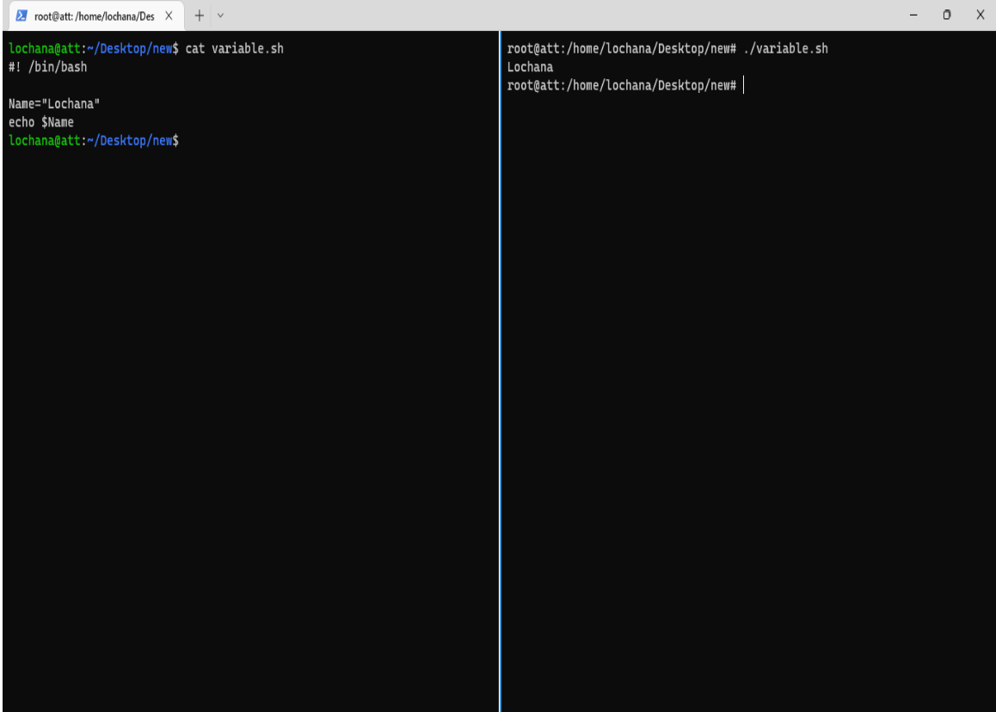
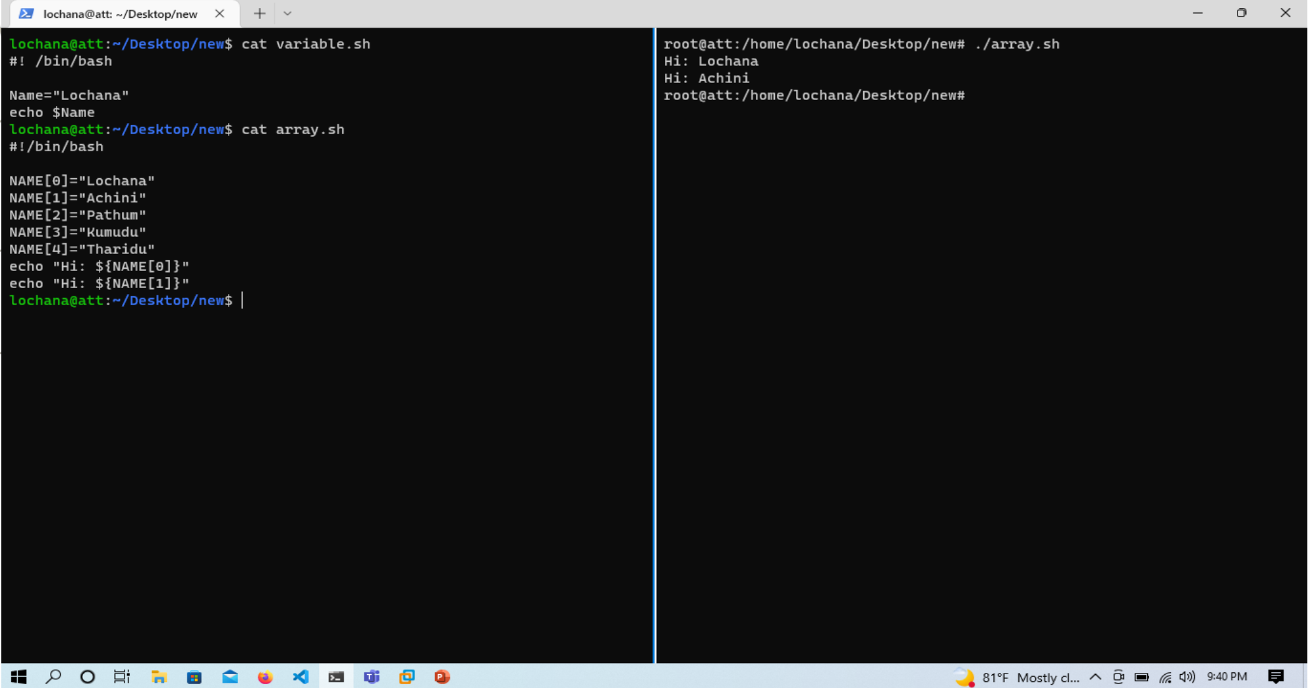
Comments
Variables
Arrays

Slide 19
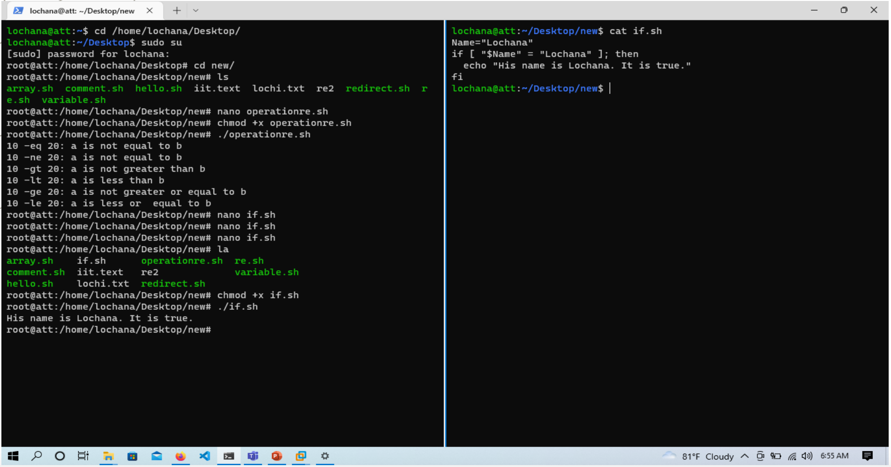
Shell Decision Making
conditional statements which are used to perform different actions
based on different conditions.

Slide 20
3.2 User and group administration

Slide 21
What is user group management?
User group is a set of people/ users with similar interests and goals.
Example:-
Using this option Bank Administrator can maintain the user groups of Bank administrator and of corporate users of same party ID. User groups maintained by administrators for Bank administrator users and corporate users are used while creating approval workflows and approval rules.
Also, the user groups created for Bank Administrator type of user are used for mapping secured mail subjects. Each subject category can be linked to a group of bank administrator users. So that administrators will receive the mails only of the subjects mapped to the users.
Pre-Requisites
Transaction access is provided to Bank Administrator.
Multiple corporate and administrator users are maintained.
Approval rule set up for Bank administrator to perform the actions.
Party preference for which the groups are to be created is maintained and is active.

Slide 22
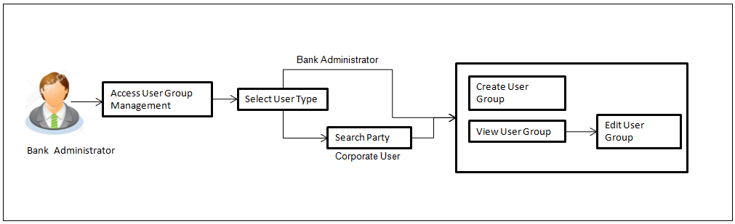
Workflow

Slide 23


Slide 24
3.3 File system management

Slide 25
What is a File System?
A file system is a method an operating system uses to store, organize, and manage files and directories on a storage device. Some common types of file systems include:
FAT (File Allocation Table): An older file system used by older versions of Windows and other operating systems.
NTFS (New Technology File System): A modern file system used by Windows. It supports features such as file and folder permissions, compression, and encryption.
ext (Extended File System): A file system commonly used on Linux and Unix-based operating systems.
HFS (Hierarchical File System): A file system used by macOS.
APFS (Apple File System): A new file system introduced by Apple for their Macs and iOS devices.

Slide 26
Q&Q Session on Lesson learned

Slide 27
Q&Q Session
Q1: Describe the steps to install a Linux operating system on a new machine.
A1:
Download the desired Linux distribution ISO file.
Create a bootable USB drive using tools like Rufus or UNetbootin.
Insert the USB drive into the new machine and boot from it.
Follow the on-screen instructions to select language, keyboard layout, and other preferences.
Partition the hard drive if necessary, choosing either automatic or manual partitioning.
Complete the installation process by setting up user accounts, passwords, and any additional configurations.
Reboot the system and remove the USB drive.

Slide 28
Q&Q Session
Q2: What is the purpose of the Windows Registry, and how is it accessed?
A2: The Windows Registry is a hierarchical database that stores low-level settings and configurations for the operating system and installed applications. It can be accessed using the Registry Editor tool, which is launched by typing regedit in the Run dialog (Win + R).
Q3: How can you configure network settings on a Linux system?
A3: The TCP/IP protocol suite consists of four layers:
Application Layer: Includes protocols like HTTP, FTP, SMTP, which provide specific data communication services.
Transport Layer: Includes TCP and UDP, which provide end-to-end communication services.
Internet Layer: Includes IP, ICMP, ARP, which handle addressing and routing of packets.
Network Interface Layer: Manages the physical transmission of data over network hardware.

Slide 29
Q&Q Session
Q3: Write a Python function to read a file and print its contents.
A2:
pythonCopy code
def read_file(file_path): with open(file_path, 'r') as file: contents = file.read() print(contents) # Usage read_file('example.txt')

Slide 30
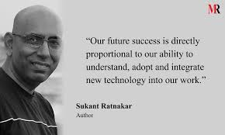

Slide 31
3.4 Python programming

Slide 32
Introduction to Phyton
Python is a high-level, interpreted, object-oriented language with dynamic semantics. Its dynamic typing and dynamic binding, along with its high-level built-in data structures, make it an appealing language for Rapid Application Development and for usage as a scripting or glue language to join existing components. Because of its straightforward, basic syntax, Python promotes readability, which lowers software maintenance costs. Python's support for packages and modules promotes code reuse and program modularity.

Slide 33
Standard Data Types :
The data stored in memory can be of many types. For example, a person's
age is stored as a numeric value and his or her address is stored as
alphanumeric characters
✓ Numbers
✓ String
✓ List
✓ Tuple
✓ Dictionary
Types of Operator
Python language supports the following types of operators.
•Arithmetic Operators
•Comparison (Relational) Operators
•Assignment Operators
•Logical Operators
•Bitwise Operators
•Membership Operators
•Identity Operators

Slide 34
Installing Python
For Windows & Mac:
﻿To install python in windows you need to download installable file from https://www.python.org/downloads/
﻿After downloading the installablfile,le you need to execute the file.
﻿For Linux:
﻿For ubuntu 16.10 or newer
﻿sudo apt-get update
﻿sudo apt-get install python3.8
﻿To verify the installation

Slide 35
Installing Python
For Windows :
﻿python -version
﻿Linux :
﻿python3 -version (linux might have python2 already installed, you can check python 2 using python --version)Alternatively, Ly we can use anaconda distribution for the python installation
﻿http://anaconda.com/downloads
﻿Anaconda comes with many useful inbuilt libraries

Slide 36
Python Lists
Lists are the most versatile of Python's compound data types. A list contains items separated by commas and enclosed within square
brackets ([]).
#!/usr/bin/python
list = [ 'abcd', 786 , 2.23, 'john', 70.2 ]
tinylist = [123, 'john']
print list # Prints complete list
print list[0] # Prints first element of the list
print list[1:3] # Prints elements starting from 2nd till 3rd
print list[2:] # Prints elements starting from 3rd element
print tinylist * 2 # Prints list two times
print list + tinylist # Prints concatenated lists

Slide 37
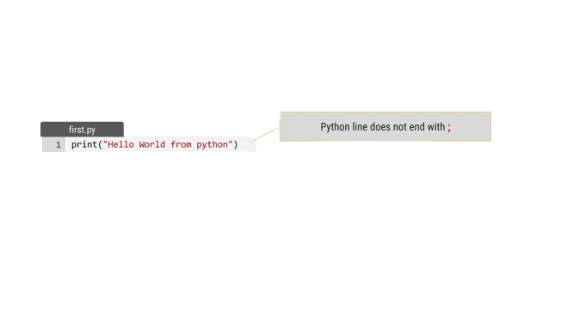
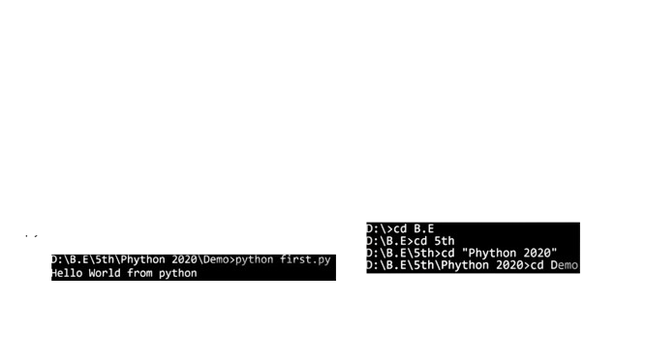
Hello World Using Python
﻿To write python programs, we can use any text editors or IDE (Integrated Development Environment), Initially we are going to use Visual Studio Code.
﻿Create new file in editor, save it as first.py (Extensions for python programs will be .py).
To run the python file open command prompt and change directory to where your python file is
Next, run python command (python filename.py)

Slide 38
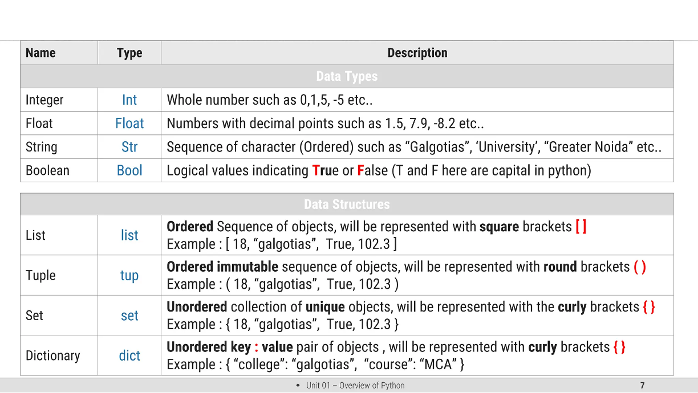
Data Types in Python

Slide 39
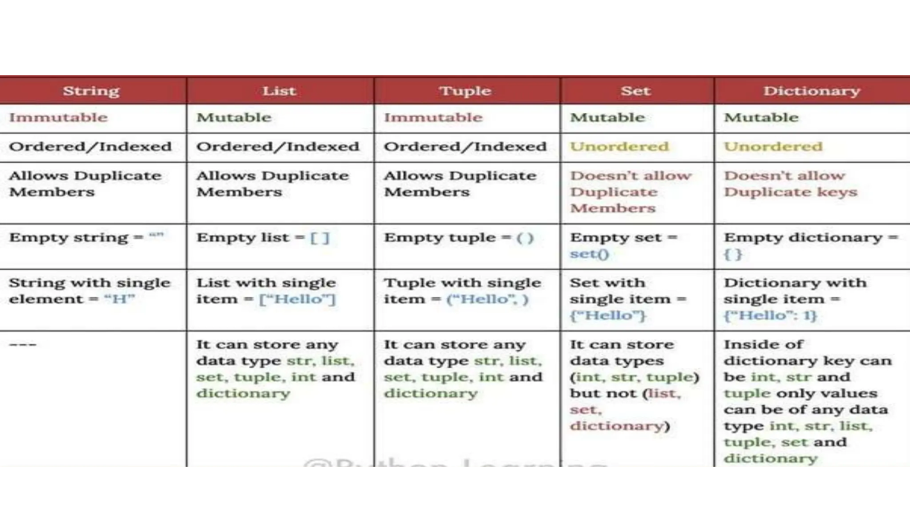
Data Types in Python

Slide 40
Variables in Python
A reserved memory address for storing values is called a Python variable.
Python has a command for declaring a variable, in contrast to most programming languages.
The instant you give a variable a value for the first time, it is formed.
Python employs dynamic typing, consequently we don't need to define the data types for the variables because the data type will be allocated to the variable internally based on the value that is assigned.
Additionally, we can reassign a different data type to the same variable; the variable's data type will immediately convert to the new data type.
Using the built-in type(variable name) function, we can determine the variable's current data type.
Variable name rules prohibit starting a string with a number
Not allowed in space
Not allowed to have special characters
Python keywords are prohibited.
Need to be in lower case

Slide 41
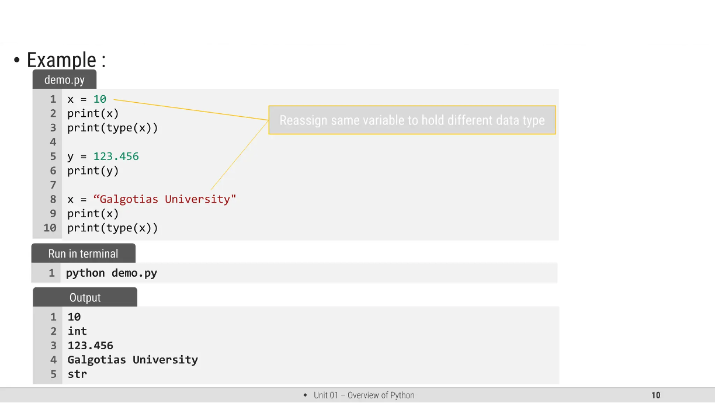
Example of Variables in Python

Slide 42
String in Python
﻿String is Ordered Sequence of character such as "Galgotias", 'University', "Greater Noida" etc..
﻿Strings are arrays of bytes representing Unicode characters.
﻿String can be represented as single, double or triple quotes.
﻿String with triple Quotes allows multiple lines.
﻿String in python is immutable.
﻿Square brackets can be used to access elements of the string, Ex. "Galgotia" [1] = a, characters can also be accessed with reverse index like "Galgotia"|-1] = a
Example:- Python Strings
str = 'Hello World!'
print str # Prints complete string
print str[0] # Prints first character of the string
print str[2:5] # Prints characters starting from 3rd to 5th
print str[2:] # Prints string starting from 3rd character
print str * 2 # Prints string two times
print str + "TEST" # Prints concatenated string

Slide 43
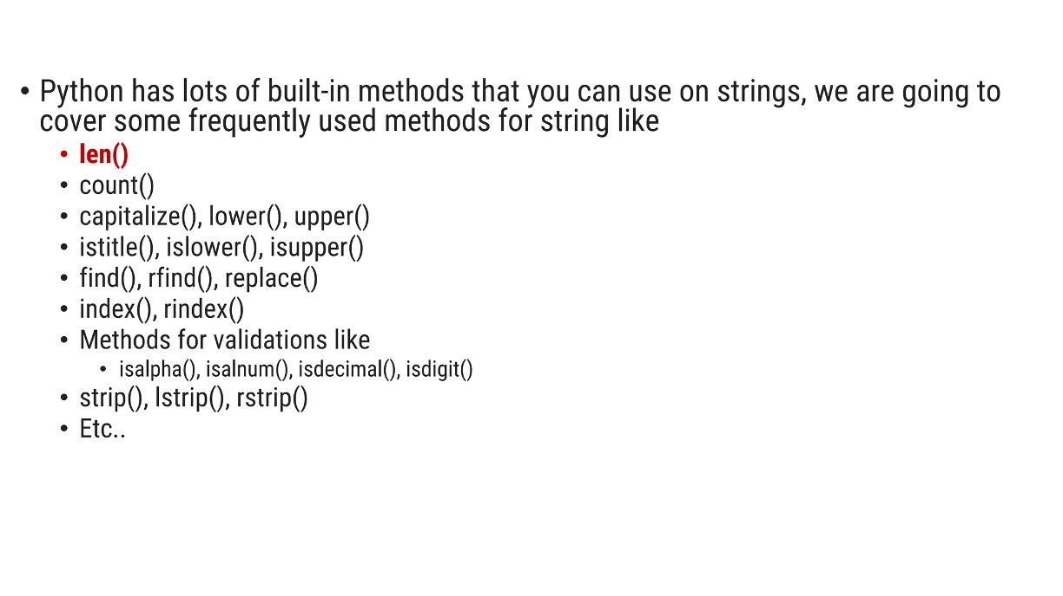
String Functions in Python

Slide 44
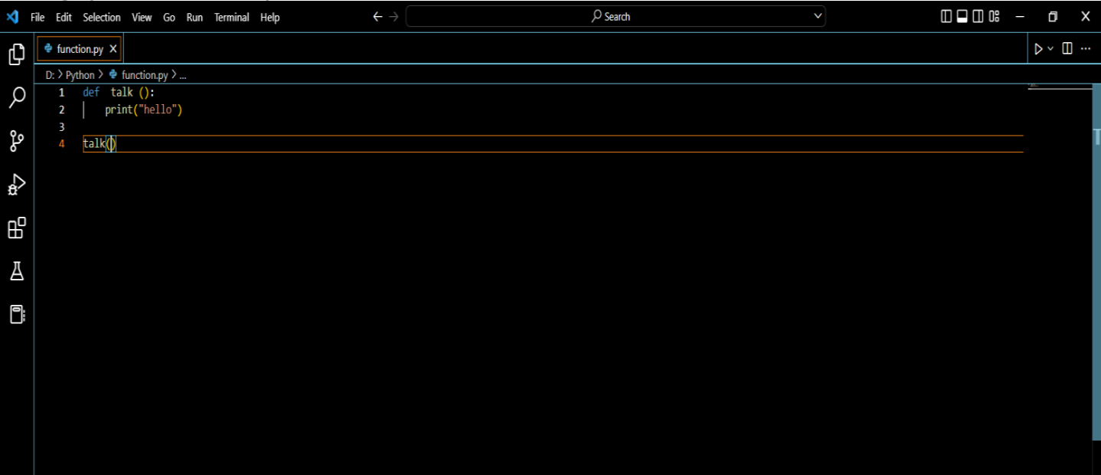
Functions in Python
A function is a block of organized, reusable code that is used to perform a single, related action. Functions provide better
modularity for your application and a high degree of code reusing

Slide 45
The steps that you need to take are:
Import the right module.
Create a variable that belongs to a class called “socket”. Set “practice” as the variable’s name.
Use the method named “connect()” to establish a connection to a port. The actual process ends here. The remaining steps will show you some of the things you can do after establishing a connection.
Use “recv” to acquire 1024 data bytes from the current socket.
Save the information in a new variable called “sample”.
Print the information inside the “sample” variable.
Terminate the connection.
Save the code as “samplesocket” and issue “chmo.
Packets
Many protocols, including the principal protocols in the Internet protocol suite, employ a technique called packetization to help manage data while it's being transmitted across a network.

Slide 46
#!usr/bin/env python
import socket
practice = socket.socket()
practice.connect((“192.168.1.107”, 22))
sample = practice.recv(1024)
print sample
practice.close
#a socket object is created for communication
clientsocket = socket.socket(socket.AF_INET, socket.SOCK_STREAM)
# now connect to the web server on port 80
# - the normal http port
clientsocket.connect(("www.google.com", 80)
serversocket = socket.socket(socket.AF_INET, socket.SOCK_STREAM)
#bind the socket to a public host and a well-known port
serversocket.bind((socket.gethostname(), 80))
#become a server socket and listen for connections
serversocket.listen(5)

Slide 47
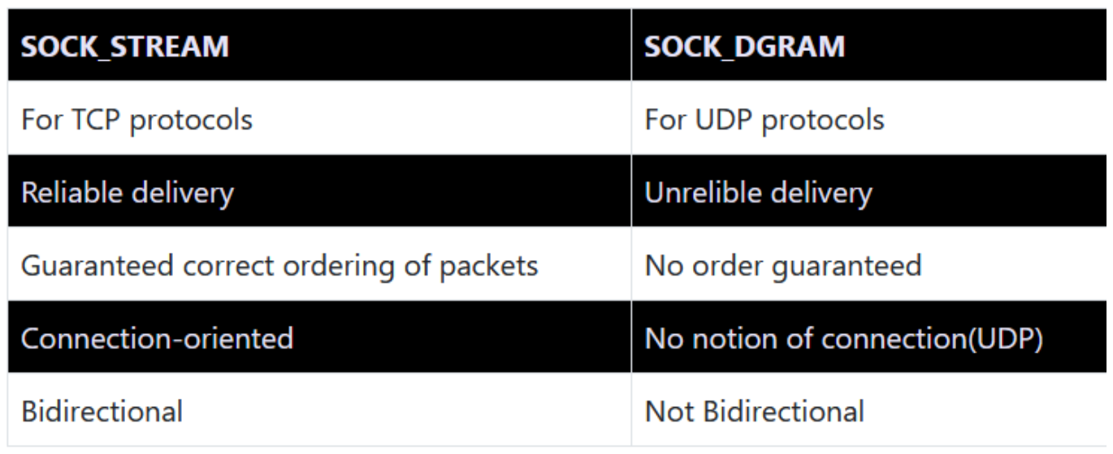
Python Sockets - SOCK_STREAM and SOCK_DGRAM
Socket Module in Python
socket_family: This is either AF_UNIX or AF_INET. We are only going to talk about INET sockets in this tutorial, as
they account for at least 99% of the sockets in use.
socket_type: This is either SOCK_STREAM or SOCK_DGRAM.
Protocol: This is usually left out, defaulting to

Slide 48
Client Socket Methods
Connect( )
To connect to a remote socket at an address. An address format(host, port) pair is used for AF_INET address family.
Server Socket Methods
Following are some server socket methods:
bind( )
This method binds the socket to an address. The format of address depends on socket family mentioned above(AF_INET).
listen(backlog)

Slide 49
Client Socket Methods
This method listens for the connection made to the socket. The backlog is the maximum number of queued connections that must be listened before
rejecting the connection.
accept( )
This method is used to accept a connection. The socket must be bound to an address and listening for connections. The return value is a pair(conn,
address) where conn is a new socket object which can be used to send and receive data on that connection, and address is the address bound to the
socket on the other end of the connection.

Slide 50
Working with TCP Sockets
!/usr/bin/python
#This is tcp_server.py script
import socket #line 1: Import
socket module
s = socket.socket() #line 2: create a
socket object
host = socket.gethostname() #line 3: Get current machine
name
port = 9999 #line 4: Get
port number for connection
s.bind((host,port)) #line 5: bind
with the address
print "Waiting for connection..."
s.listen(5) #line 6:
listen for connections
while True:
conn,addr = s.accept() #line 7: connect
and accept from client
print 'Got Connection from', addr
conn.send('Server Saying Hi')

Slide 51
Working with TCP Sockets
!/usr/bin/python
#This is tcp_client.py script
import socket
s = socket.socket()
host = socket.gethostname() # Get current machine name
port = 9999 # Client wants
to connect to server's
# port number 9999
s.connect((host,port))
print s.recv(1024) # 1024 is bufsize
or max amount
# of data to be received at once
s.close()

Slide 52
Requests with urllib
from urllib.request import urlopen
response = urlopen('http://www.debian.org')
Response
Response objects
response.url
response = urlopen('http://www.debian.org’)
response.read(50)
response.status
import urllib.error
from urllib.request import urlopen
try:
urlopen('http://www.ietf.org/rfc/rfc0.txt')
except urllib.error.HTTPError as e:
print('status', e.code)
print('reason', e.reason)
print('url', e.url)
def download_file(bucket, s3_name, local_path):
url = 'http://{}.{}/{}'.format(bucket, endpoint, s3_name)
r = requests.get(url, auth=auth)
if r.ok:
open(local_path, 'wb').write(r.content)
print('Downloaded {} OK'.format(s3_name))
else:
xml_pprint(r.text)

Slide 53
Group Discussion
Installing Operating System
User and Group Management
File System Management
What is Phyton

